Slide 1

8th Grade Math: Pre-Algebra
Unit 11, Lesson 1 Representing Bivariate Data Volume 2, pg. 177

Slide 2


Benchmark
MA.8.DP.1.1
Given a set of real-world bivariate numerical data, construct a scatter plot or a line graph as appropriate for the context.
volume 2, pg. 177

Slide 3
Integrated Mathematical Thinking and Reasoning Standards
MA.K12.MTR.2.1 Demonstrate understanding by representing problems in multiple ways.
MA.K12.MTR.6.1 Assess the reasonableness of solutions.
MA.K12.MTR.7.1 Apply mathematics to real-world contexts.
volume 2, pg. 177

Slide 4

Learning Targets
I can determine the independent and dependent variables in a given set of real-world bivariate data.
I can determine if the data is best represented by a line graph or scatter plot.
I can determine an appropriate scale for the axis representing each variable.
volume 2, pg. 177

Slide 5

Warm-Up
volume 2, pg. 177

Slide 6
11.1.1 Warm-Up: Army Dentist
When Captain Ryan Romero was asked how he got started as an Army dentist, he said his first job was to be a dental assistant. He was sitting on the other side of the chair helping the dentist and he enjoyed it so much that he decided to pursue a career in Army dentistry.
When thinking about your future career, it’s helpful to explore areas of interest to help you identify careers you might like. What is a career you think you would like to have?
What could you do now or in the future to help you determine if that is a career you would enjoy?
volume 2, pg. 177

Slide 7

Guided Instruction
volume 2, pg. 178

Slide 8
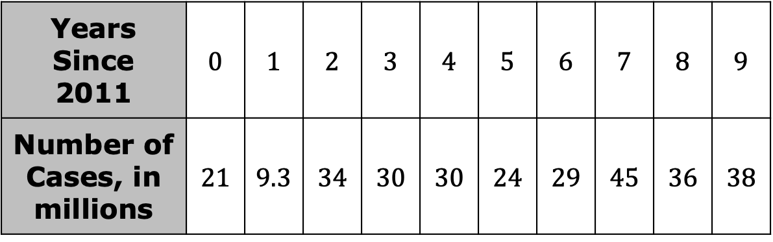

11.1.2 Guided Instruction: Representing Bivariate Data
The U.S. Centers for Disease Control and Prevention (CDC) is the nation’s health protection agency. Epidemiologists at the CDC study the spread and impact of diseases. The table shows the number of symptomatic cases of influenza, also called the flu, in millions, in the U.S. since 2011.
What year does the number $6$ represent?
Years Since 2011 | $$0$$ | $$1$$ | $$2$$ | $$3$$ | $$4$$ | $$5$$ | $$6$$ | $$7$$ | $$8$$ | $$9$$
Number of Cases, in millions | $$21$$ | $$9.3$$ | $$34$$ | $$30$$ | $$30$$ | $$24$$ | $$29$$ | $$45$$ | $$36$$ | $$38$$
volume 2, pg. 178

Slide 9
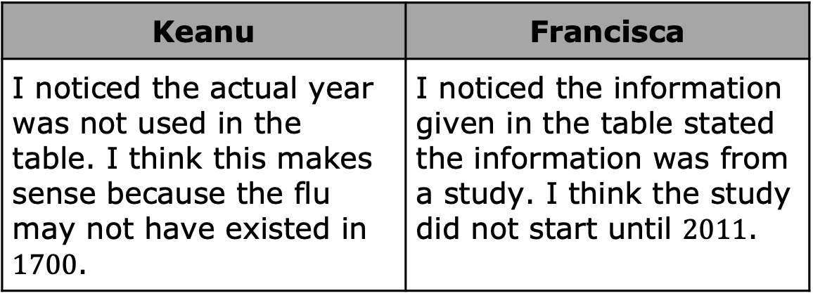
Keanu and Francisca were discussing what they noticed about the values in the table.
Discuss Keanu’s and Francisca’s ideas with your partner.
Keanu | Francisca
I noticed the actual year was not used in the table. I think this makes sense because the flu may not have existed in $1700$. | I noticed the information given in the table stated the information was from a study. I think the study did not start until $2011$.
volume 2, pg. 178

Slide 10

Discuss with your partner what you notice in the data. Summarize your discussion.
This data set is an example of bivariate data because two variables are being compared.
Based on the definition of bivariate data, what are the two characteristics measured in the table?
Bivariate data is data that measures two characteristics of a population.
volume 2, pg. 178

Slide 11
Bivariate numerical data can be represented in different ways. One way to represent the data is a scatter plot with a line of fit.
A scatter plot is a graph in the coordinate plane representing a set of bivariate numerical data that is used to observe the relationship between two variables.
A line of fit is a line drawn on a scatter plot to estimate the relationship between two sets of data. A line of fit is also known as a trend line.
volume 2, pg. 179

Slide 12
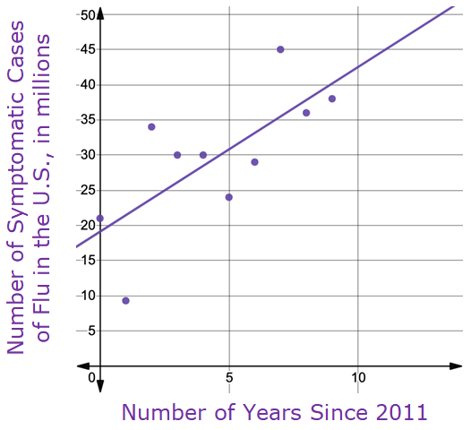
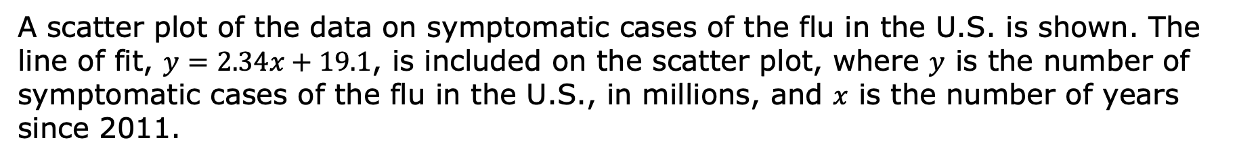
A scatter plot of the data on symptomatic cases of the flu in the U.S. is shown. The line of fit, $y=2.34x+19.1$, is included on the scatter plot, where $y$ is the number of symptomatic cases of the flu in the U.S., in millions, and $x$ is the number of years since 2011.
volume 2, pg. 179

Slide 13
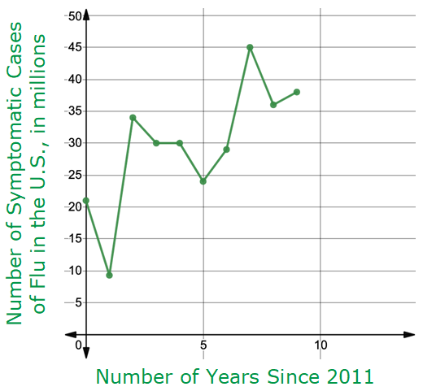
The same data can be represented using a line graph.
A line graph of the data on symptomatic cases of the flu in the U.S. is shown.
A line graph is a graph that displays numerical data using connected line segments.
volume 2, pg. 179

Slide 14
Discuss with your partner the similarities and differences between the scatter plot and the line graph.
Complete the table.
Similarities Between Scatter Plots and Line Graphs | Differences Between Scatter Plots and Line Graphs
volume 2, pg. 179

Slide 15
Mateo is interested in determining how the number of flu cases in the U.S. has changed each year since 2011. Explain which graph is best for him to use.
Londyn is interested in the overall trend in the number of flu cases in the U.S. since 2011. Explain which graph is best for her to use.
volume 2, pg. 180

Slide 16

Discuss with your partner which variable is the independent variable and which is the dependent variable in this context. Identify your choices.
Independent Variable | Number of cases of the flu Years since 2011
Dependent Variable | Number of cases of the flu Years since 2011
Both scatter plots and line graphs can be used to observe the relationship between two variables in a set of bivariate data. While overall trends can be seen in both graphs, line graphs allow for closer analysis from one point to another in the data set.
volume 2, pg. 180

Slide 17

Guided Practice
volume 2, pg. 180

Slide 18

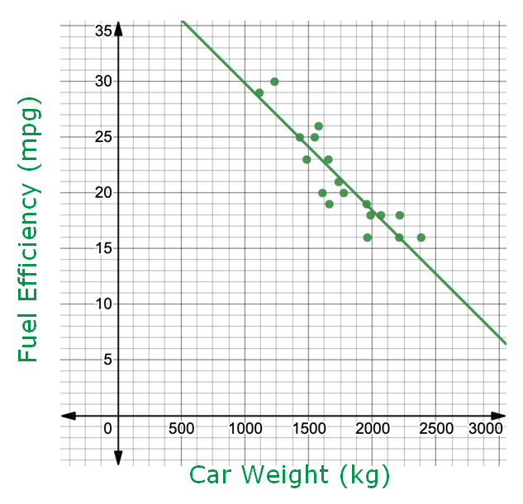
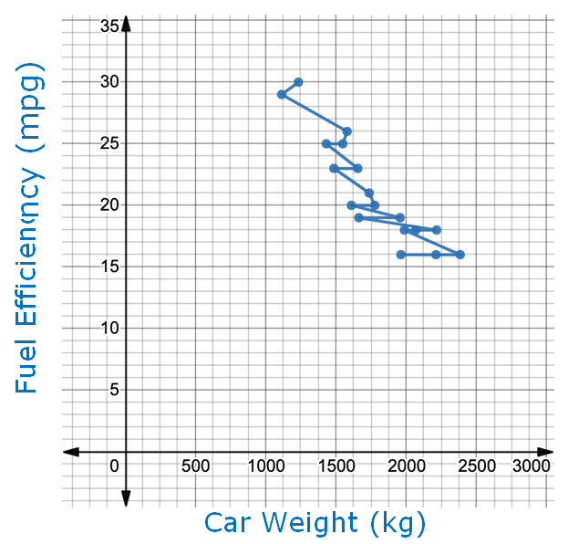
11.1.3 Guided Practice: Representing Bivariate Data
A scatter plot and a line graph comparing the weights, in kilograms (kg), and fuel efficiencies, in miles per gallon (mpg), of $18$ cars are shown.
volume 2, pg. 180

Slide 19
Discuss with your partner which graph you think more clearly shows the relationship between a car’s weight and its fuel efficiency. Summarize your discussion.
Complete the statement to describe the relationship shown on the graph identified in Part A.
The graph shows that, in general, a car’s fuel efficiency as the car’s weight increases.
increases
decreases
volume 2, pg. 181

Slide 20

Kate noticed that there were cars of two different weights with the same fuel efficiency of $25$ mpg. How does this impact the visual representation of the data on the line graph?
When the goal of analyzing a set of bivariate numerical data is to observe the relationship between the two variables overall, a scatter plot is most useful.
volume 2, pg. 181

Slide 21
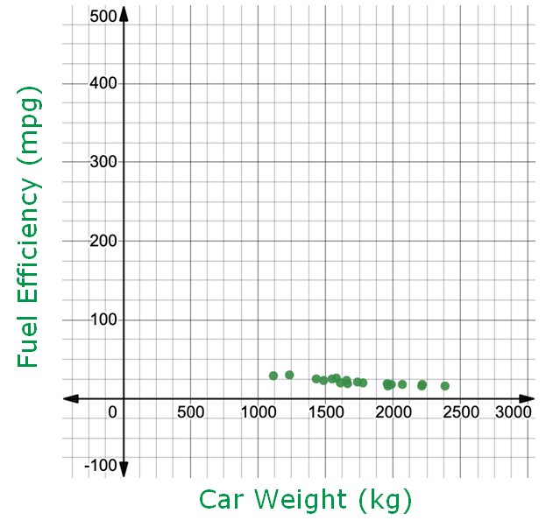
A scatter plot representing the same bivariate data set, but using a different scale is shown.
Explain how the change in scale could influence how the relationship between the two variables is interpreted.
volume 2, pg. 181

Slide 22

Collaboration
volume 2, pg. 182

Slide 23

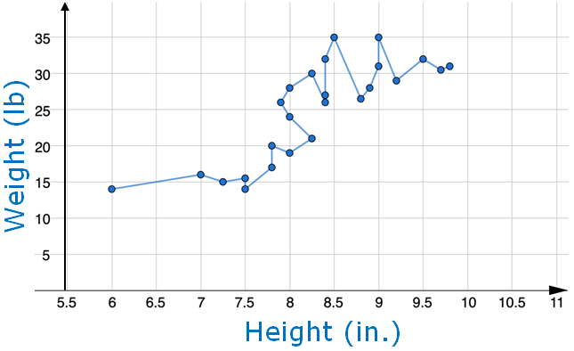
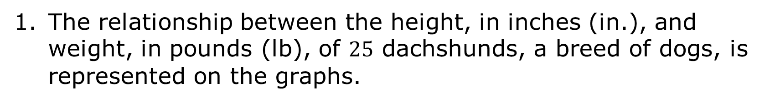
11.1.4 Collaboration: Choosing an Appropriate Graph
The relationship between the height, in inches (in.), and weight, in pounds (lb), of $25$ dachshunds, a breed of dogs, is represented on the graphs.
Line Graph A
volume 2, pg. 182

Slide 24
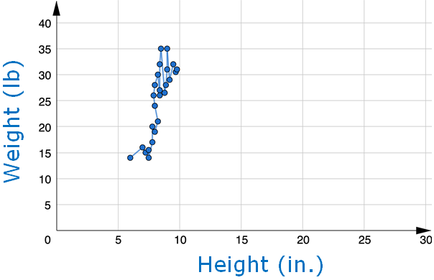
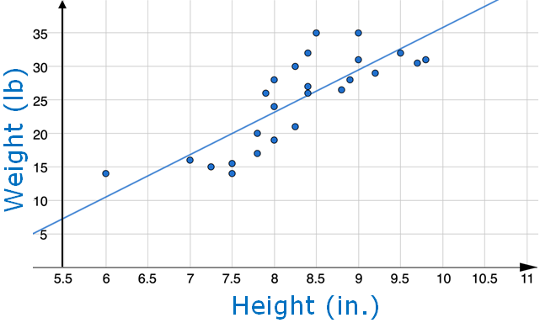
Line Graph B
Scatter Plot A
volume 2, pg. 182

Slide 25
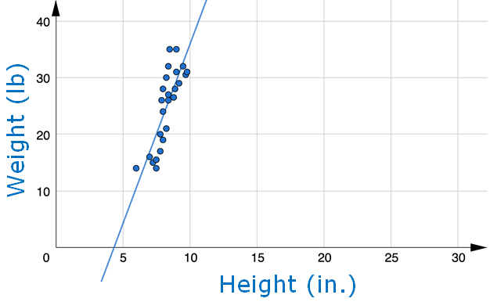
Scatter Plot B
Work with your partner to explain which of the graphs is best to show the relationship between the weight and height of these dogs. Be sure to include information about the type of graph and the scale in your explanation.
Describe the relationship between a dachshund’s height and its weight using the graph identified in Part A.
volume 2, pg. 182

Slide 26
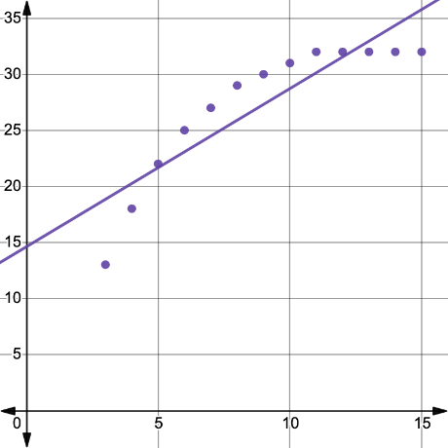
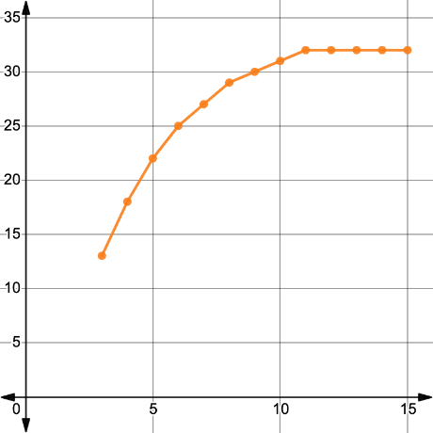
The relationship between the age of a dachshund, in months, and its weight, in pounds (lb), is shown on the graphs.
Explain which of the graphs best demonstrates the relationship between the age and weight of dachshunds.
Scatter Plot
Line Graph
Weight (lb)
Weight (lb)
Age (months)
Age (months)
volume 2, pg. 183

Slide 27

Wrap-Up
volume 2, pg. 183

Slide 28



11.1.5 Wrap-Up: Reflection
Circle the icon that best describes your understanding of each learning target.
I need help. I got it. I could help someone.
I can determine the independent and dependent variables in a set of real-world bivariate data.
I can determine if the data is best represented by a line graph or scatter plot.
I can determine the best scale for the axis for which each variable will be represented.
volume 2, pg. 183

